Slide 1
Light Sensor Lab
By: Alan, Wedge, and Ray

Slide 2
Problem Statement
Design and construct a robot that follows the path in the shortest time possible.
Constraints & Criteria for Subproblems
Use of light sensors
HandyBoard
Follow continuous path
Two Trials
Inaccurate light values
Unequal motors

Slide 3
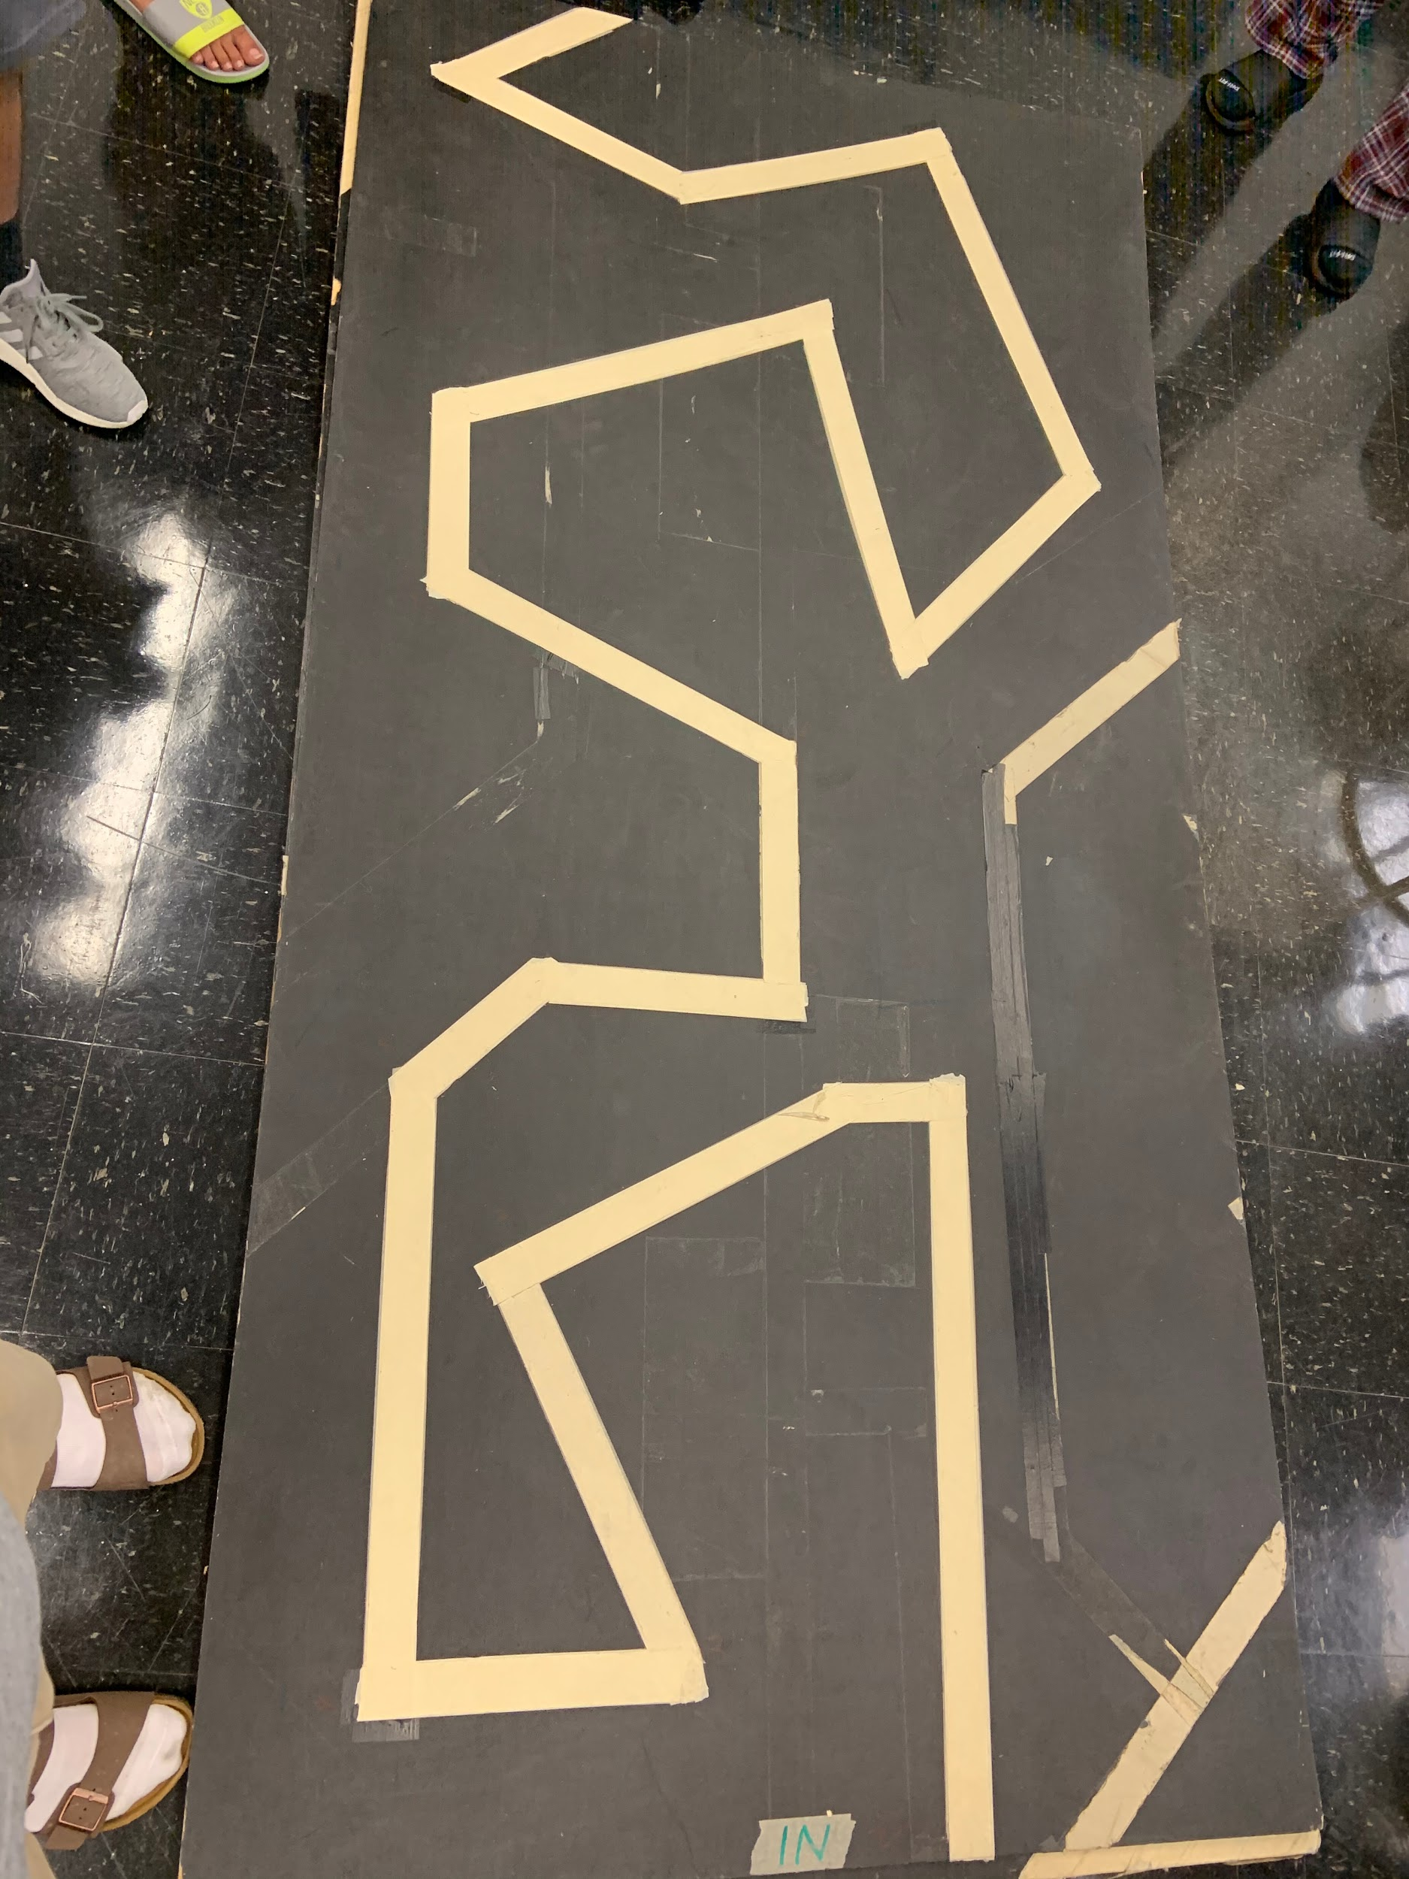
Research/Investigation
Building an optimized robot :
Utilizing normalize function
Removing normalize function
Sensors off the tape
Correct gear ratio
Functioning equipment
Correct light values

Slide 4
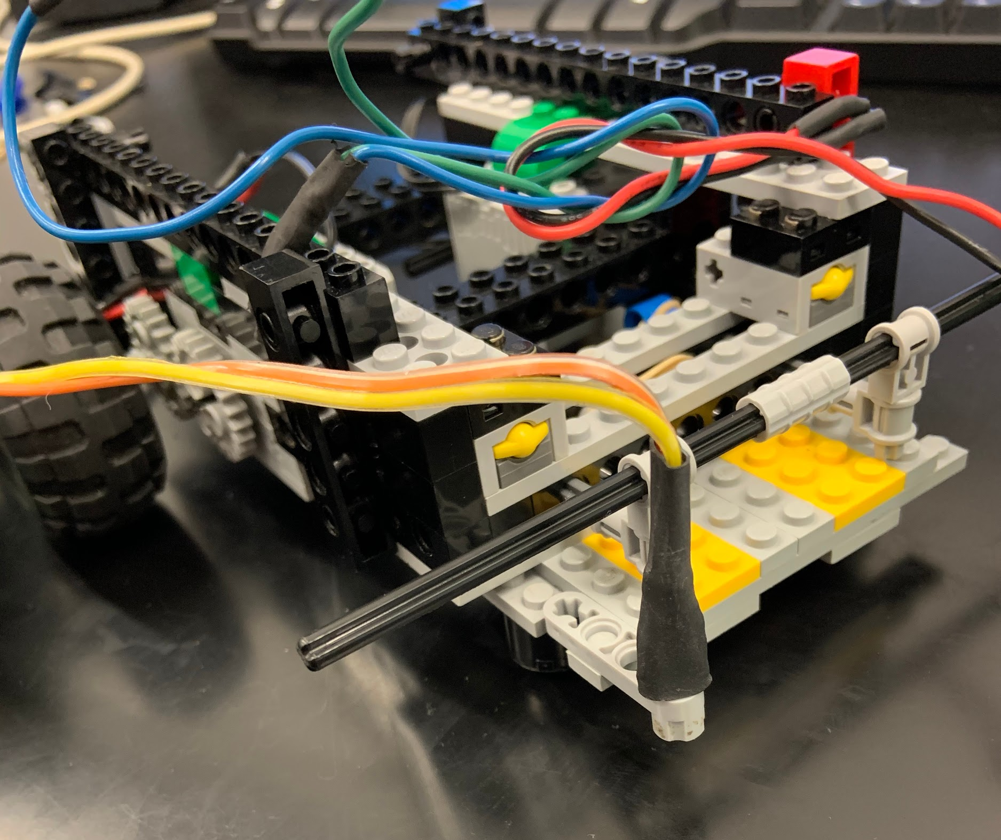
Design & Construction
The design was from Robotic Explorations by Fred G. Martin[pg 71].
The two light sensors were faced down and attached on the sides of the HandyBug.
The two light sensors detected difference in light intensity.
The robot had the same construction from the previous lab; the only change was the gear ratio was switched down from 1:1 to 1:8 to decrease the speed of the robot.
The robot tires and the axles were changed in order for it to move without any drag.

Slide 5
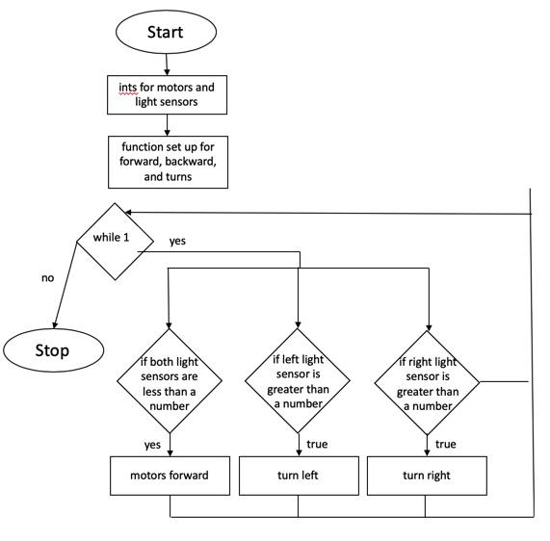
Code
int LEFT_MOTOR = 3;
int RIGHT_MOTOR = 0;
int LEFT_EYE = 6;
int RIGHT_EYE = 2;
void forward()
{
motor(LEFT_MOTOR, 100);
motor(RIGHT_MOTOR,50);
}
void main(){
int RIGHTDSTART = analog(RIGHT_EYE);
int LEFTDSTART = analog(LEFT_EYE);
while(1){
if(analog(LEFT_EYE) - LEFTDSTART < -5){
motor(RIGHT_MOTOR, 50);
motor(LEFT_MOTOR, 0);
}
else if(analog(RIGHT_EYE) - RIGHTDSTART < -5){
motor(LEFT_MOTOR, 100);
motor(RIGHT_MOTOR, 0);
}
else{
forward();
}
}
}

Slide 6
Alterations made on the code
Original plan
Same as previous code, except contained within one if statement
Secondary plan
Normalize functions for motors movement
Final plan
Simple code that ended up working for the the test runs, requiring minor tweaks

Slide 7
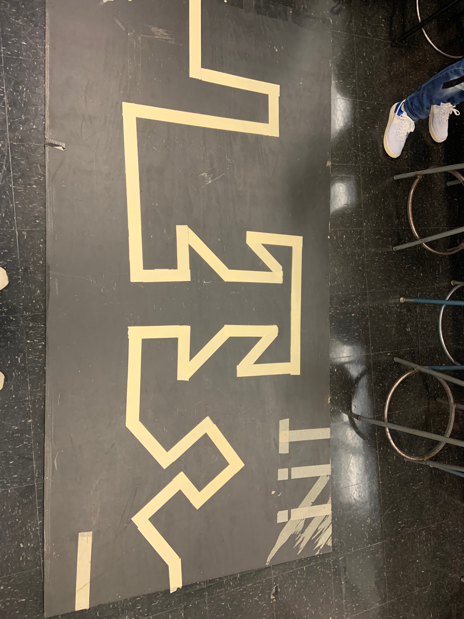
Testing
The robot had been tested during the 3 labs.
The final hardware design & software configurations was tested in lab 3.After the first run, it was found that the HandyBoard and light sensors both were faulty due to which the final trial couldn’t be done.
The structure was built well and didn’t break apart during lab trials.
During the competition, due to improper handyboard the robot couldn’t participate. Thus was only able to earn itself 1 points on the maze.

Slide 8
Final Evaluation
Possible Problems:
The program of normalize function is too slow for the robot to complete the maze.
FAULTY handy board.
Faulty light sensors.
Solutions:
Don’t use normalize function, and don’t hardcore the variables [as the light intensity can change every time].
Check the hardware before downloading the code.
Use tape to get secure wire connections between motors/ sensors and the handy board.
Precautions for future work:
Take in account of the problems, start the solutions from scratch. Using different method is useful.

